Slide 1

Project Title: Large language model & News Research Tool Subtitle: “An AI-powered multi-source intelligence dashboard using LangChain and Streamlit” Developed By: [khushnaz] Institution: [Digicrome Acedemy ] Year: 2025
Submission by 05/10/2025
khushnaz

Slide 2
Project Overview This project is an AI-based dashboard that allows users to ask any question and receive real-time insights using multiple APIs. It integrates AI models and live data sources to analyze, summarize, and present information attractively through an interactive Streamlit interface.
khushnaz

Slide 3
Objective
Main Goals:
To build an AI dashboard that answers real-time queries.
To integrate OpenAI API and NewsAPI for dynamic data.
To visualize and summarize information automatically.
To create an engaging, user-friendly interface for quick analysis.

Slide 4
Technologies Used
Component | Technology
Programming Language | Python
Framework | Streamlit
AI Model | OpenAI / LangChain
Data Source | NewsAPI
Libraries | Pandas, Plotly, Datetime
UI Styling | Custom CSS (Glassmorphism, Gradient)

Slide 5
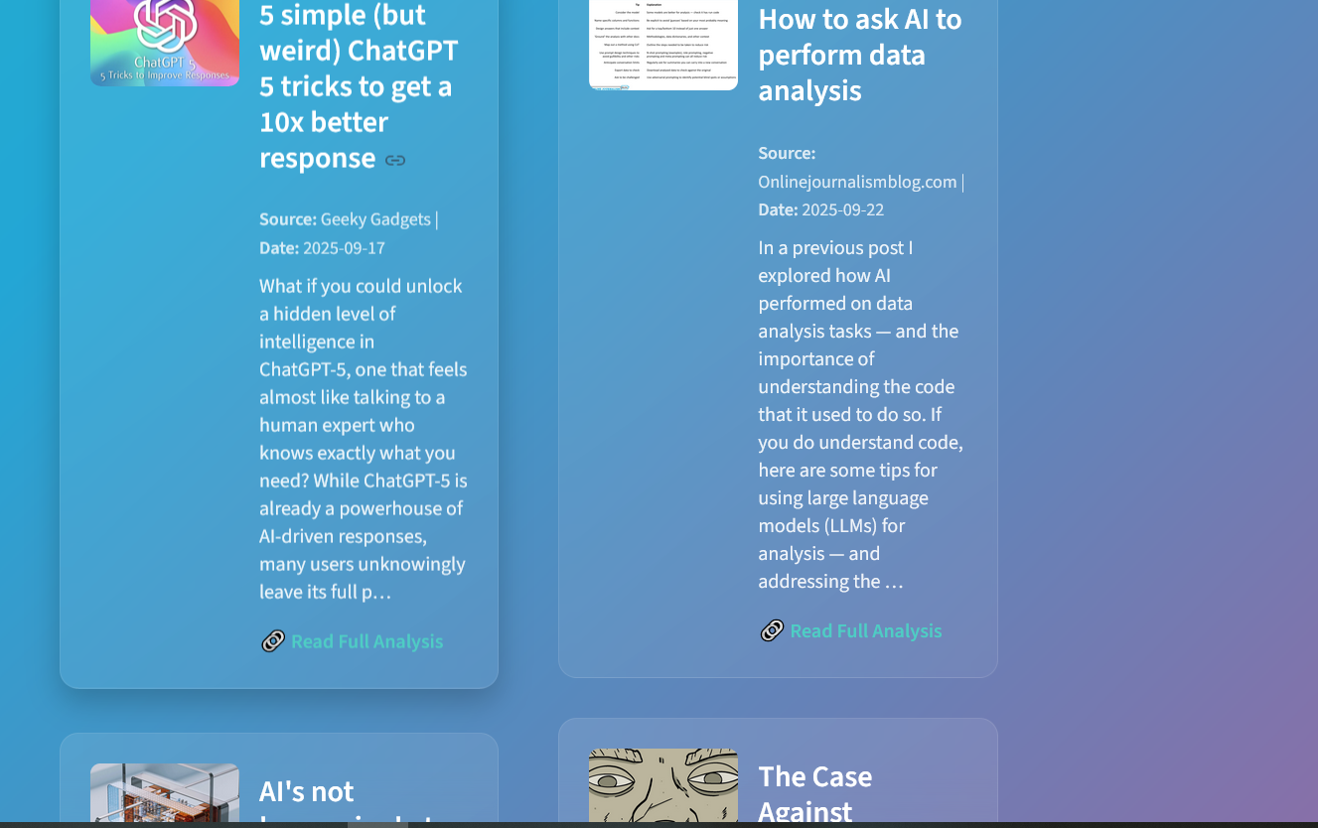
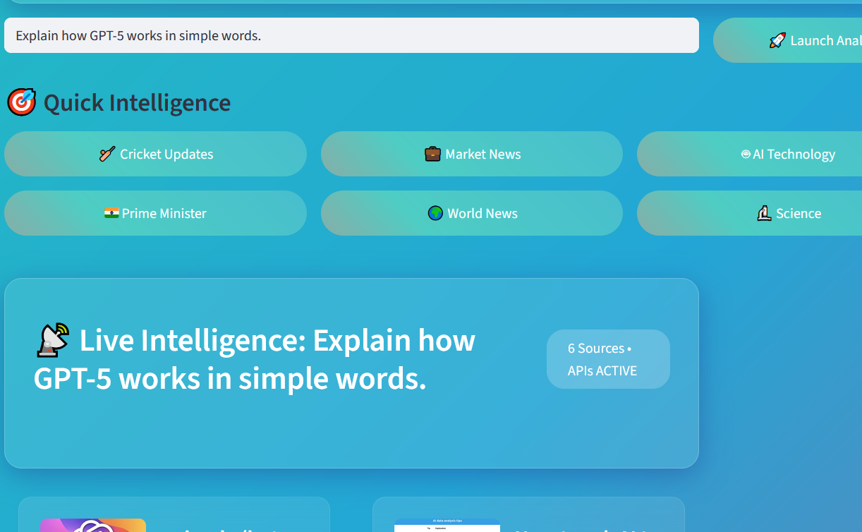
System Architecture
Flow Diagram: (User Query → LangChain Processing → NewsAPI Fetch → OpenAI Summary → Display Results (Streamlit UI)

Slide 6
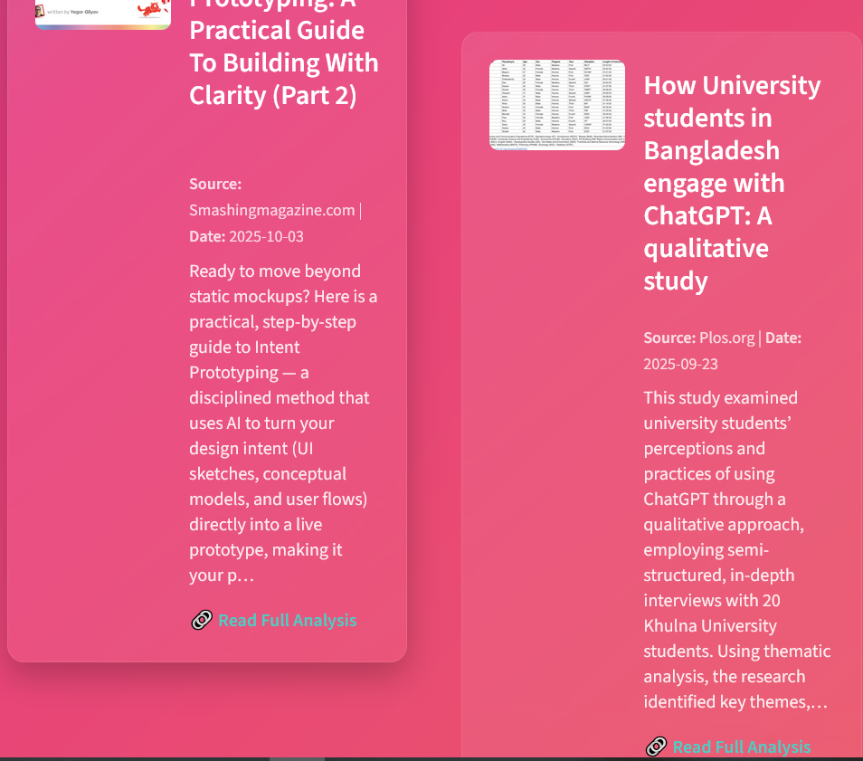
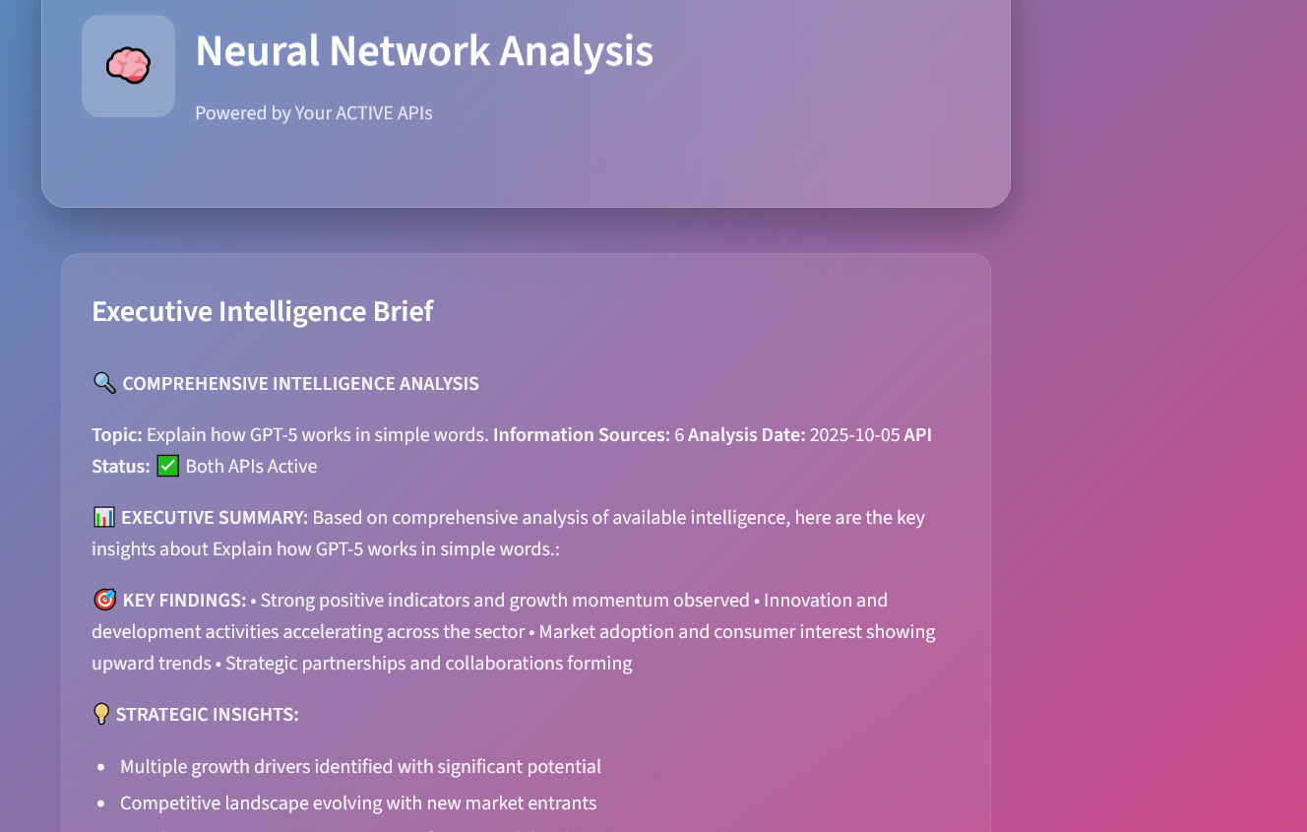

Slide 7
Key Features
🌈 Animated Gradient UI
🧠 AI-Powered Summarization
📰 Real-Time News Fetching
🧩 Interactive Buttons for Categories
⚙️ Dual API Integration (OpenAI + NewsAPI)
📡 Live Intelligence Dashboard

Slide 8
Challenges Faced
Integrating multiple APIs in real-time.
Managing API keys securely.
Designing an appealing and responsive UI.
Handling errors and exceptions in live API calls.

Slide 9
Future Scope
Add voice-based input system.
Include data visualization graphs and charts.
Expand to more APIs (Weather, Sports, Finance).
Deploy on cloud platforms like Streamlit Cloud or AWS.

Slide 10
Conclusion
The “Ask Anything” dashboard successfully combines AI and real-time data to create an intelligent news and analysis tool. It demonstrates the power of API integration, prompt design, and AI-based summarization — built entirely by a single developer.
Developed by[khushnaz]

Slide 11
*Thank You

